Slide 1

Analyzing and Classifying Digital Time Signals Using Convolutional Neural Networks for Source Identification
Time-Series Classification Using Convolutional Neural Networks
Presented by:
Bidhan Paul 1427608 Fahim Talukdar 1428610
Submitted to:
Prof. Dr. Andreas Pech Frankfurt University of Applied Scineces

Slide 2
Introduction
Background: Time-series data is prevalent in various domains such as finance, healthcare, and engineering. Accurate classification of these signals is crucial for informed decision-making.
Objective: Develop a robust Convolutional Neural Network (CNN) model for binary classification of time-series signals and deploy it through a user-friendly GUI.

Slide 3
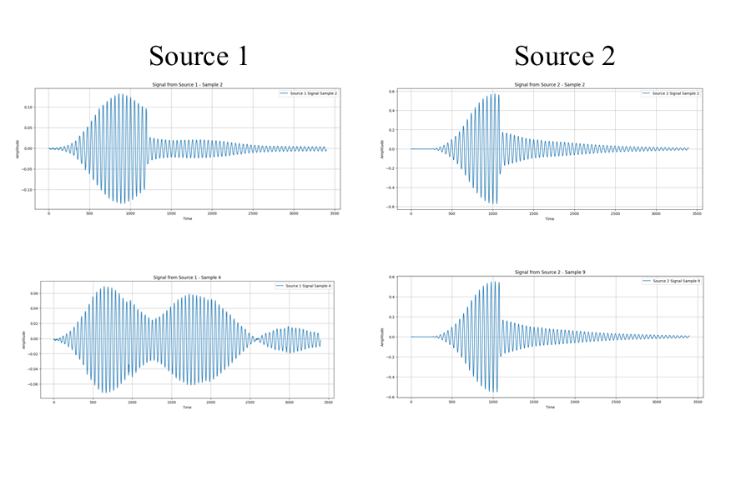
Data Visualization and Preprocessing
Data Source Source 1 Source 2
Data Characteristics: Type: Time-series signals Features: Columns G to DZZ selected for analysis
Labels: Object-1 labeled as 0 Object-2 labeled as 1 Preprocessing Steps: Handling missing values by replacing NaN with zero Wavelet-based denoising using Daubechies 4 ('db4') wavelet Feature normalization with StandardScaler.

Slide 4
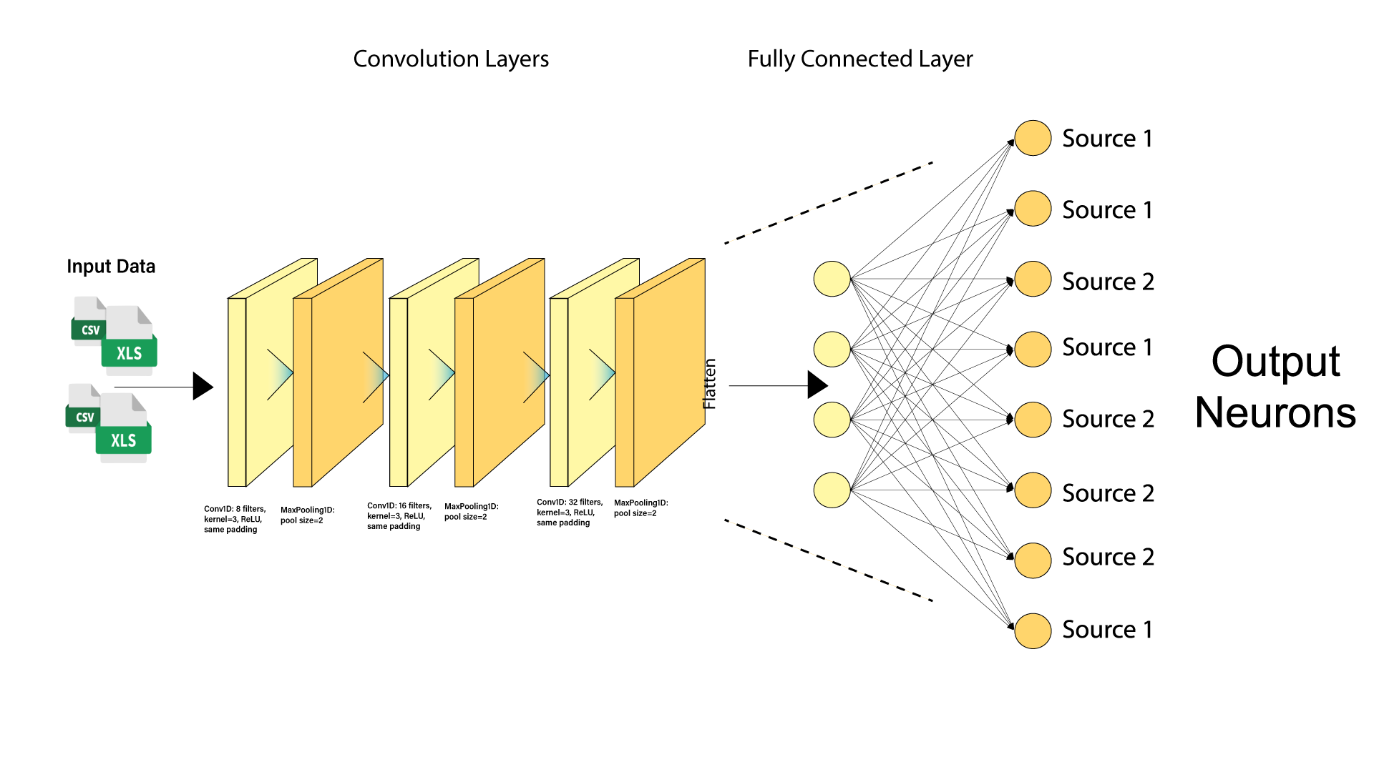
Model Architecture
Convolutional Layers:
Conv1D Layer 1: 8 filters, kernel size 3, ReLU activation, same padding
MaxPooling1D Layer 1: Pool size 2
Conv1D Layer 2: 16 filters, kernel size 3, ReLU activation, same padding
MaxPooling1D Layer 2: Pool size 2
Conv1D Layer 3: 32 filters, kernel size 3, ReLU activation, same padding
MaxPooling1D Layer 3: Pool size 2
Flatten and Dense Layers:
Flatten Layer: Converts 3D tensor to 1D vector
Dense Layer: 64 neurons, ReLU activation
Dropout Layer: 50% dropout rate to prevent overfitting
Output Layer: 1 neuron, sigmoid activation for binary classification

Slide 5
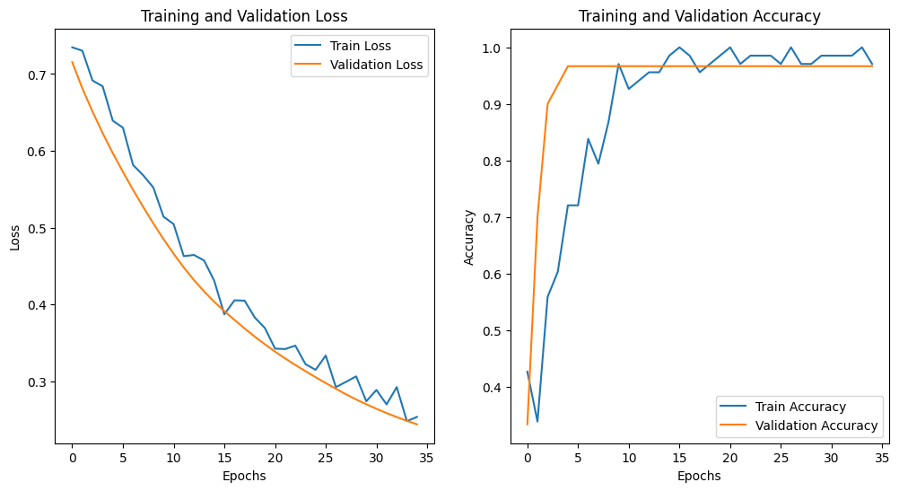
Training and Validation
Training Process:
Epochs: 35
Batch Size: 64
Callbacks: Early Stopping (patience=5), Learning Rate Scheduler (factor=0.5, patience=3)
Performance Trends:
Accuracy:
Training accuracy increased from 41.97% to 97.00%
Validation accuracy stabilized at 96.67% from the second epoch onward
Loss:
Training loss decreased consistently
Validation loss also decreased, indicating good generalization

Slide 6
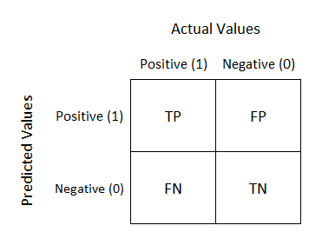
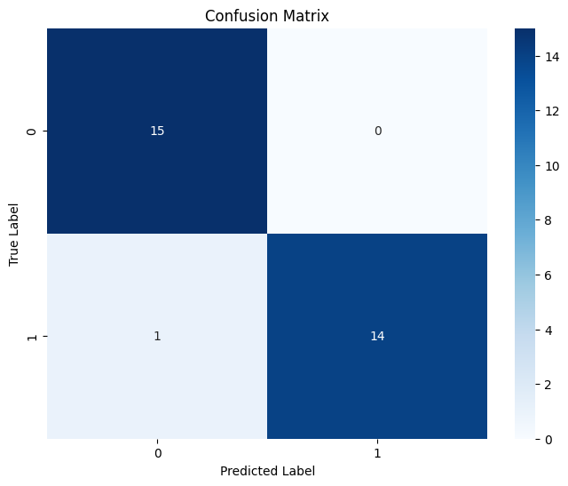
Confusion Matrix
The confusion matrix provides a detailed breakdown of the model’s classification
performance on the validation set.
Results:
True Positives (TP): Correctly predicted Object-2 samples
True Negatives (TN): Correctly predicted Object-1 samples
False Positives (FP): Object-1 samples incorrectly predicted as Object-2
False Negatives (FN): Object-2 samples incorrectly predicted as Object-1
Interpretation:
High number of TP and TN indicates effective classification
Low FP and FN suggest minimal misclassifications

Slide 7
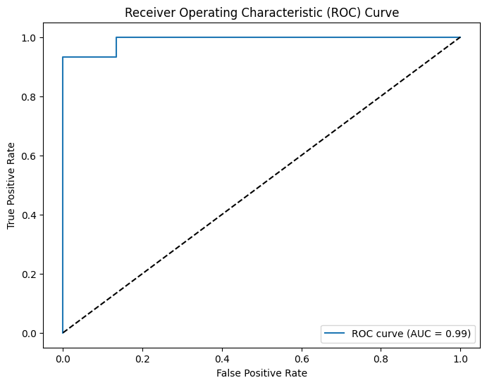
ROC Curve and AUC
ROC Curve:
Plots True Positive Rate (TPR) against False Positive Rate (FPR) at various threshold settings.
AUC (Area Under the Curve):
Achieved an AUC of 0.99, indicating excellent discriminative ability.
Significance:
A high AUC reflects the model’s capability to distinguish between the two classes effectively.
The ROC curve near the top-left corner signifies high sensitivity and specificity.

Slide 8
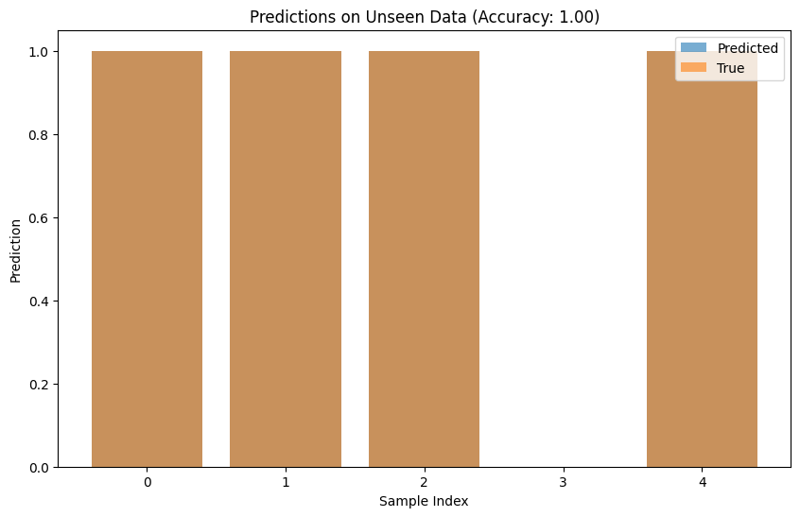
Testing on Unseen Data
Procedure:
Selected 5 random samples from the validation set for testing.
Predicted labels and probabilities were generated using the preserved model.
Results:
Accuracy on Unseen Data: 98%
Predictions vs. True Labels:
Majority of predictions matched the true labels,
demonstrating high reliability.
Implications:
The model maintains strong performance on new, unseen data, confirming its generalization capabilities

Slide 9
GUI Application
Developed a graphical user interface (GUI) using the Tkinter library to facilitate user interaction with the preserved model.
Features:
Data Upload: Users can upload new signal data files directly through the interface.
Signal Visualization: Uploaded signals are plotted for visual analysis.
Prediction: Users can obtain real-time predictions for the uploaded signals.
Save Functionality: Allows saving of model configurations and prediction results for future reference.
User Experience:
Intuitive and user-friendly, enabling non-technical users to leverage the model’s capabilities without requiring coding knowledge.
Streamlined workflow from data input to prediction output enhances usability and accessibility.

Slide 10
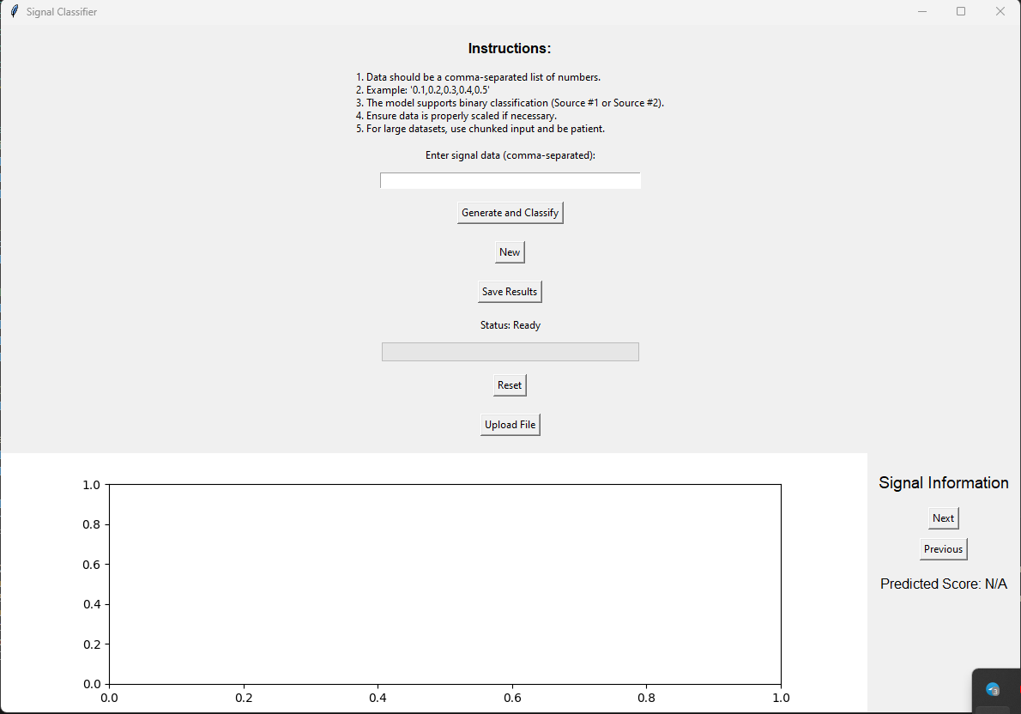
GUI Application

Slide 11
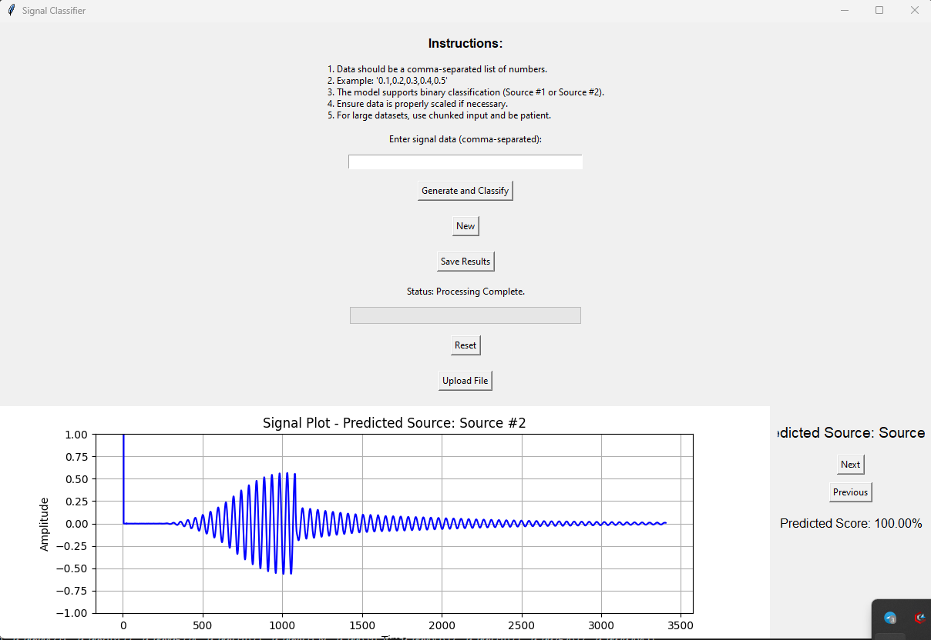
GUI Application

Slide 12
Conclusion
Summary of Findings:
Successfully developed and trained a CNN model achieving 98.50% training accuracy and 96.67% validation accuracy.
The model demonstrated high precision, recall, and an AUC of 0.96, indicating excellent classification performance.
GUI Deployment:
Implemented a Tkinter-based GUI, enhancing the model’s accessibility and practical applicability.

